Slide 1
Configuration Management

Slide 2
Introduction
Brief history and background
Mutable vs immutable infrastructure
What is configuration management?
How is this different from Terraform?
What is Puppet?
What is Chef?
Upcoming mentoring sessions
Notes:
We’ll cover a brief history and some of my personal work experience to provide context to the requirement of configuration management.
We’ll cover mutable vs immutable infrastructure.
A deep dive into what configuration management is.
How this is different to Terraform.
A brief introduction to Puppet and Chef.
Finally what the next mentoring sessions will cover.

Slide 3
Brief history
Before automation and cloud, servers were manually provisioned
Manual configuration changes cause “configuration drift”
Automation requirements led to configuration (and change) management tools to stop “configuration drift”
Chef and Puppet are the most popular configuration management tools
Notes:
Manual provisioning:
Rack physical servers
Install OS, software
Configure Windows features and roles
Configure Linux security and settings
Repeat process on single servers
Configuration drift:
Changes to registry settings, services, files, folders, software etc
Makes ongoing management and operations very difficult!
Makes software delivery using DevOps very difficult as you may have differing environment configurations which impact production deployments
Troubleshooting problems with servers is a time-consuming and manually intensive process.
Without configuration management, you are unable to make assumptions about your infrastructure — such as which version of Apache you have or whether your colleague configured the machine to follow all the manual steps correctly.
Automation:
Configuration drift led to a requirement for configuration and change management.
Basic scripts may have been used which were dependent on experience and knowledge within the team.
Microsoft released some PowerShell DSC tools to help combat in Windows environments but again requires experience and knowledge.
Eventually more tools began to surface to help combat configuration drift like Chef and Puppet.

Slide 4
Mutable vs Immutable Infrastructure
Mutable | Immutable
A mutable resource can be changed after it’s creation. | An immutable resource cannot be changed after deployment.
Changes can be applied in place. | Changes require new resource deployments.
Legacy platforms and software managed this way. | Newer pattern, cloud native.
Notes:
Before moving on it’s good to get an understanding of mutable vs immutable infrastructure.
In recent times, immutable infrastructure is becoming more popular and it is a huge shift. Traditionally, all infrastructure has been mutable. But as they say, change is the only constant.
Mutable
Possible to login to servers, apply patches, update configuration, scale up/down etc.
Changes are applied in place, i.e. once they are deployed you can RDP or SSH in
Majority of legacy platforms and applications are mutable, they do and will change over time using methods that are not tracked, undocumented and difficult to troubleshoot without the experience of existing team members that were involved in those mutable changes.
Makes identification, control and auditing difficult or impossible.
Immutable:
An infrastructure paradigm in which servers are never modified after deployment. If something needs to be updated, fixed or modified new resources need to be deployed.
New resources deployed using Terraform, ARM etc.
A newer pattern and shift towards cloud native.
We don’t care about single servers, we care about groups of servers providing a service or function. We should be able to take out one or more server and replace them with ease with no impact as the deployment is based on a set of requirements.
This is how most large services work, for example Netflix
https://netflix.github.io/chaosmonkey/

Slide 5
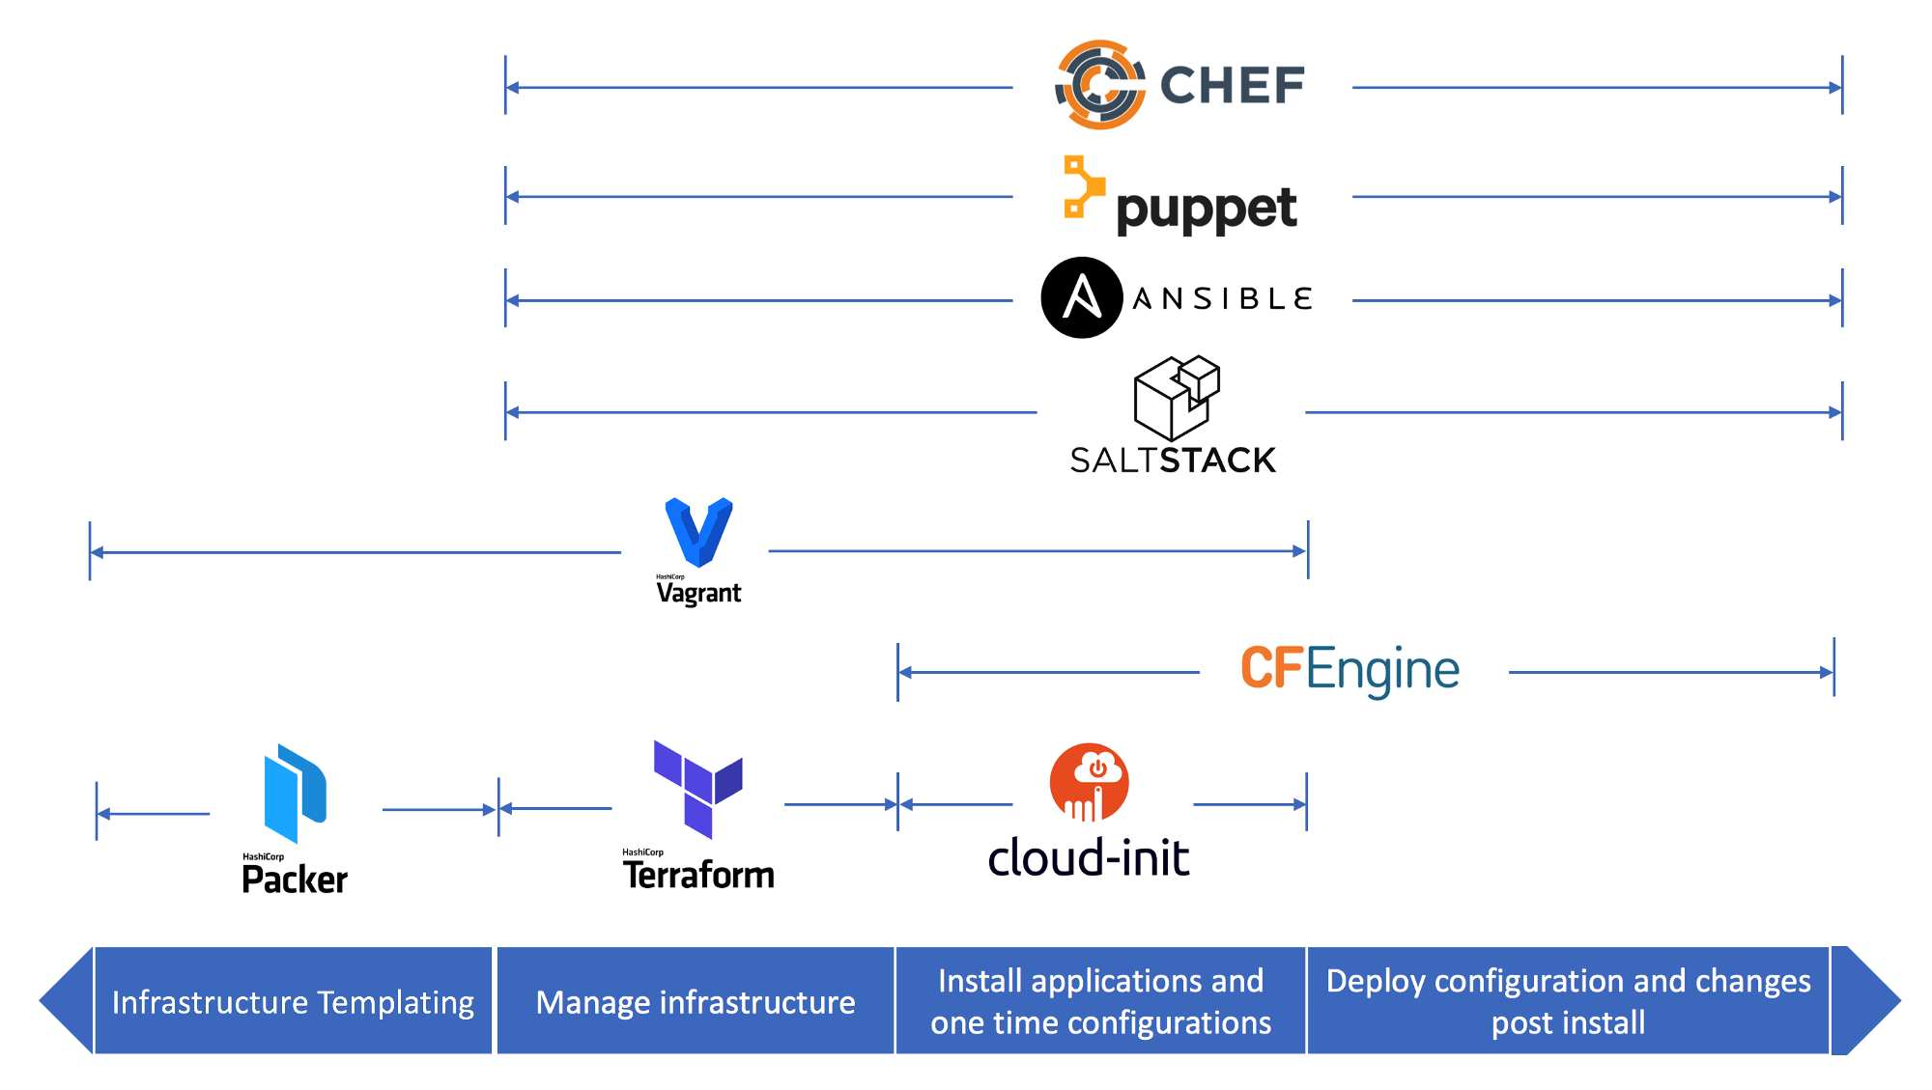
What is Configuration Management?
Designed to install and manage software and settings on existing servers.
Uses Mutable Infrastructure.
Benefits:
Consistency
Automation
Git and Version Control
Example tools:
Chef
Puppet
Ansible
Notes:
Configuration Management is used to install, manage and operate settings and software on existing servers. This is to do something to a server after it’s been deployed.
Configuration management tools typically default to a mutable infrastructure paradigm.
Configuration management is closely associated with change management, and as a result, the two terms are sometimes confused.
Configuration management is most readily described as the automation, management, and maintenance of configurations at each state, while change management is the process by which configurations are redefined and changed to meet the conditions of new needs and dynamic circumstances.
Consistency:
Troubleshooting problems with servers is a time-consuming and manually intensive process.
Without configuration management, you are unable to make assumptions about your infrastructure.
But when you use configuration management, you are able to validate that a tool like Puppet applied the desired state you wanted.
Automation:
When you manage a set of servers in your infrastructure, you want to keep them in a certain state.
If you only have to manage 10 servers, you can do so with a script or by manually going into each server.
In this case, a tool like Puppet may not provide much extra value. But if you have 100 or 1,000 servers, a mixed environment, or you have plans to scale your infrastructure in the future, it is difficult to do this manually.
Git and version control
Store your configuration management desired state files, runbooks, cookbooks etc into version control, you can then apply DevOps, CI/CD, Agile etc around it.
Chef, Puppet, Ansible, and SaltStack are all configuration management tools, which means they are designed to install and manage software on existing servers.

Slide 6
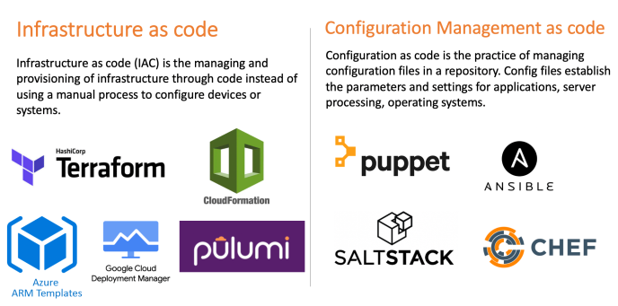
How is this different from Terraform?
Terraform is a Provisioning tool, also referred to as Infrastructure as Code.
Uses the Immutable Infrastructure paradigm.
Notes:
Terraform is a provisioning tool and uses immutable paradigm in that you can destroy and redeploy resources completely to make changes rather than update them in place.
Everything is code and run from a CI/CD pipeline, no manual changes by remoting into a server or portal.
Infrastructure as Code deploys resources, configuration management takes over to manage and provision settings.
There is some overlap between Terraform, Puppet and Chef in that some IaC tools like Terraform can perform configuration management, and tools like Puppet/Chef can do provisioning of new resources. However typically they have their use cases in each field.

Slide 7
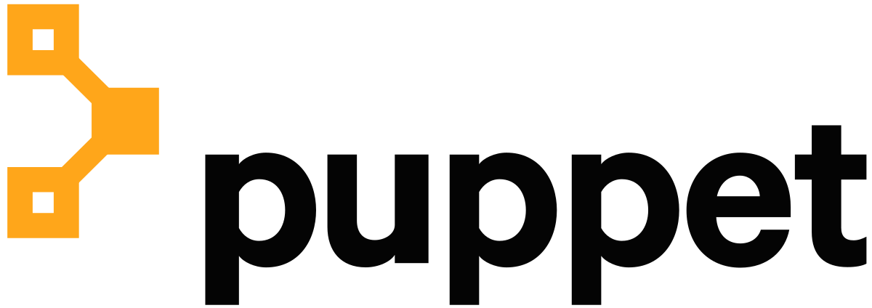
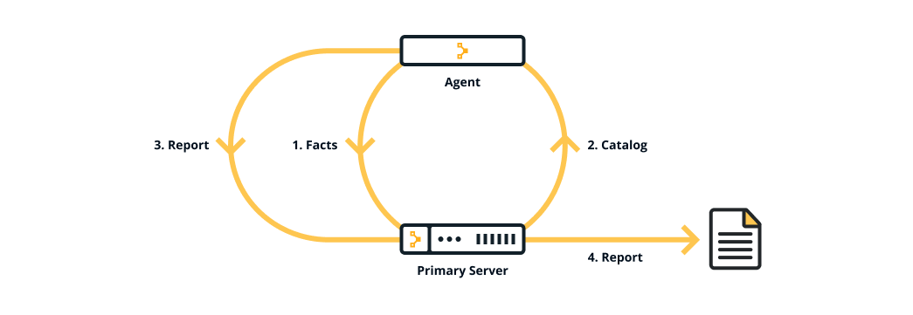
What is Puppet?
A configuration management tool for centralising and automating configuration management.
Notes:
Puppet is a configuration management tool.
Allows Infrastructure as Code to be used to define your puppet configurations. Allowing you to perform DevOp practises like version control, peer review, automated testing, and continuous deployment.
Downtime due to configuration issues is reduced to a minimum.
Provides significant time saving with speed of deployment
Supported by open source developers
Automate repetitive tasks
Supports wide range of platforms (Windows, Linux etc)
Easy to learn and use
When you use Puppet, you define the desired state of the systems in your infrastructure that you want to manage.
Puppet code is declarative, which means that you describe the desired state of your systems, not the steps needed to get there.
Puppet then automates the process of getting these systems into that state and keeping them there.
Puppet does this through Puppet primary server and a Puppet agent. The Puppet primary server is the server that stores the code that defines your desired state.
The Puppet agent translates your code into commands and then executes it on the systems you specify, in what is called a Puppet run.

Slide 8
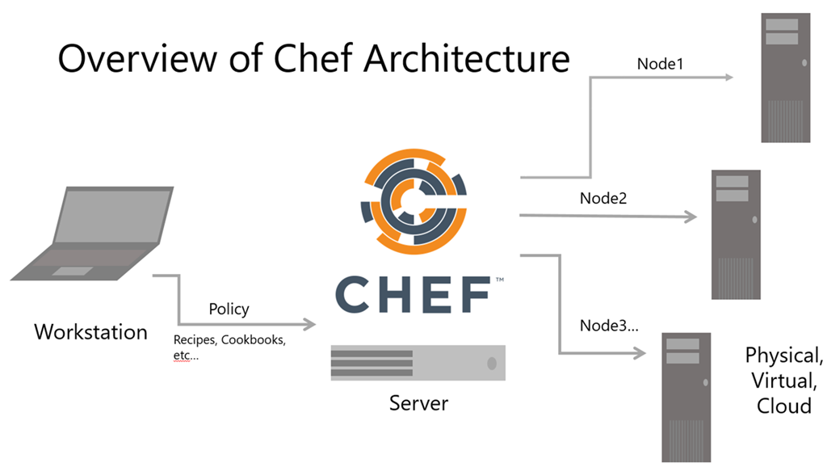
What is Chef?
A configuration management tool for centralising and automating configuration management.
Benefits of Chef:
Confidence through code
Drift elimination
Manage disparate systems as one
Extreme flexibility
Notes:
Chef® Infra® configuration management software eliminates manual efforts and ensures infrastructure remains consistent and compliant over its lifetime — even in the most complex, heterogenous, and large-scale environments.
The same principles apply to Chef as they do Puppet but architecture, tooling and terminology is different.
Confidence Through Code
Define configurations and policies as code that are testable, enforceable and can be delivered at scale as part of automated pipelines.
Drift Elimination
Ensure configurations only change if a system diverges from the desired defined state and automatically correct configuration drift, if needed.
Manage Disparate Systems as One
Manage Windows and Linux systems running on prem, ARM systems running in the cloud or Macs laptops running at the edge all the same way.
Extreme Flexibility
Use simple declarative definitions for common tasks or easily extend them to support the most unique environmental requirements.

Slide 9
Upcoming Mentoring Sessions
Configuration management demo
Puppet deep dive
Chef deep dive
Notes:
Configuration management demo:
In this demo we’ll deploy some servers and look at how configuration drift occurs and how it impacts everyone from customers, business stakeholders and engineers.
Good to get a feel for how legacy systems and applications are managed.
Basic automation.
Puppet deep dive:
We’ll deploy Puppet and configure some servers.
Chef deep dive:
We’ll deploy Chef and configure some servers.

Slide 10
Any Questions?

